Slide 1

Flappy Bird in Pygame
By: Jane Bombria
CS 3080 002
Professor Z

Slide 2

Background
Game Design and Development focus + minor
Unity
Unreal Engine

Slide 3
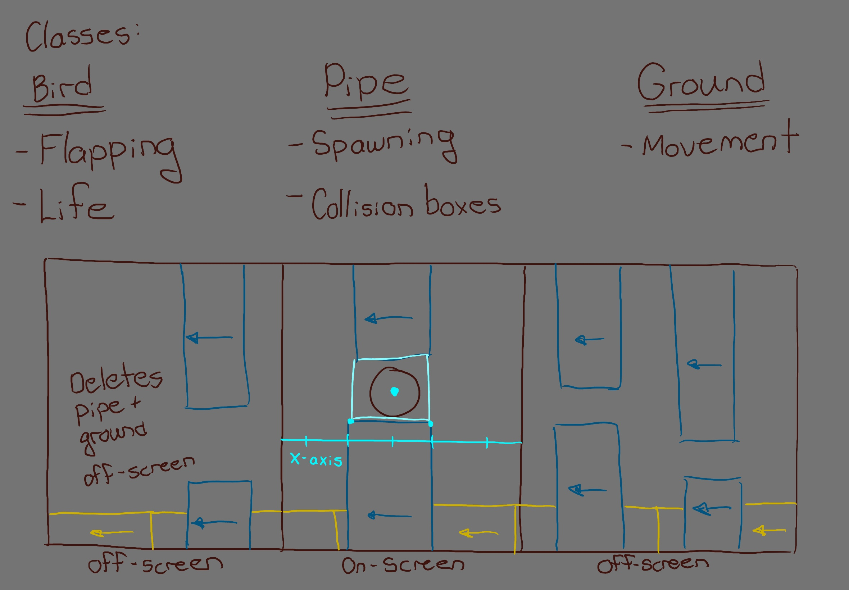
Flow

Slide 4
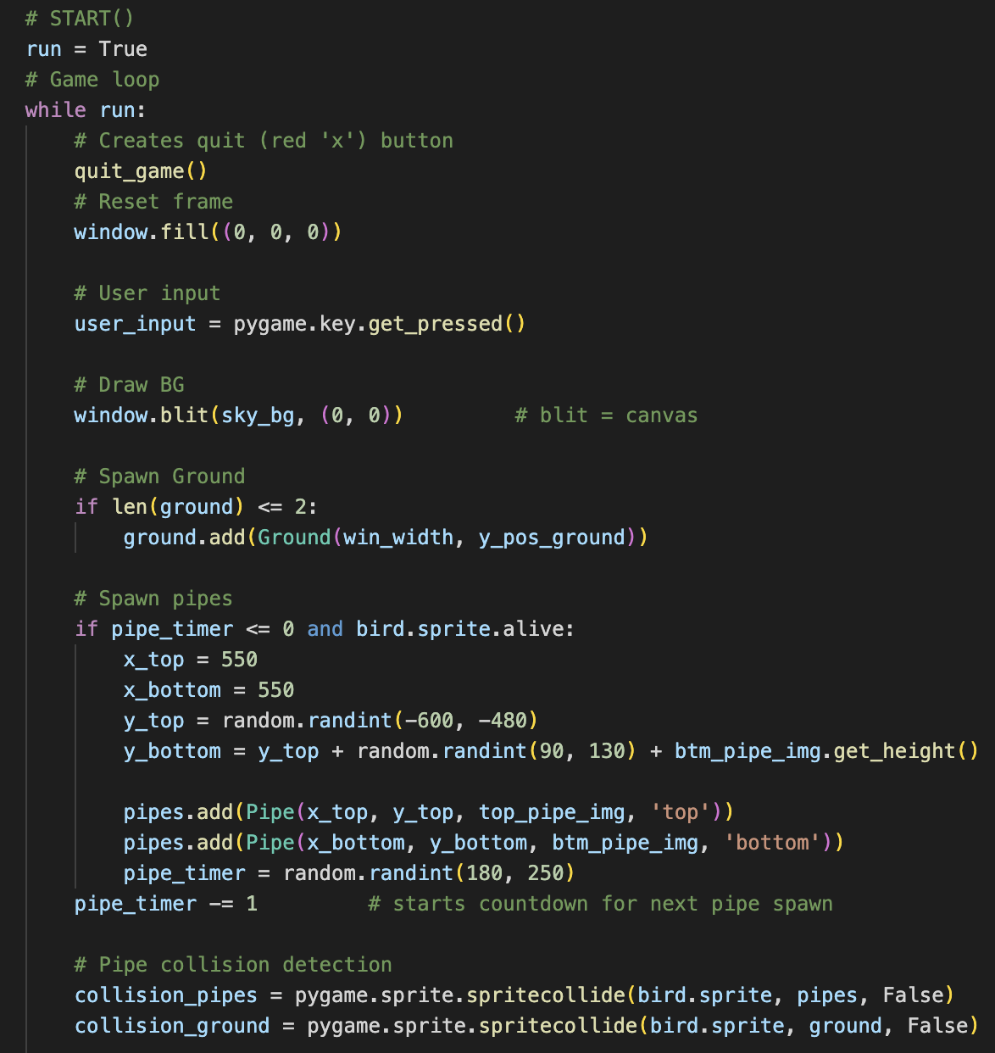
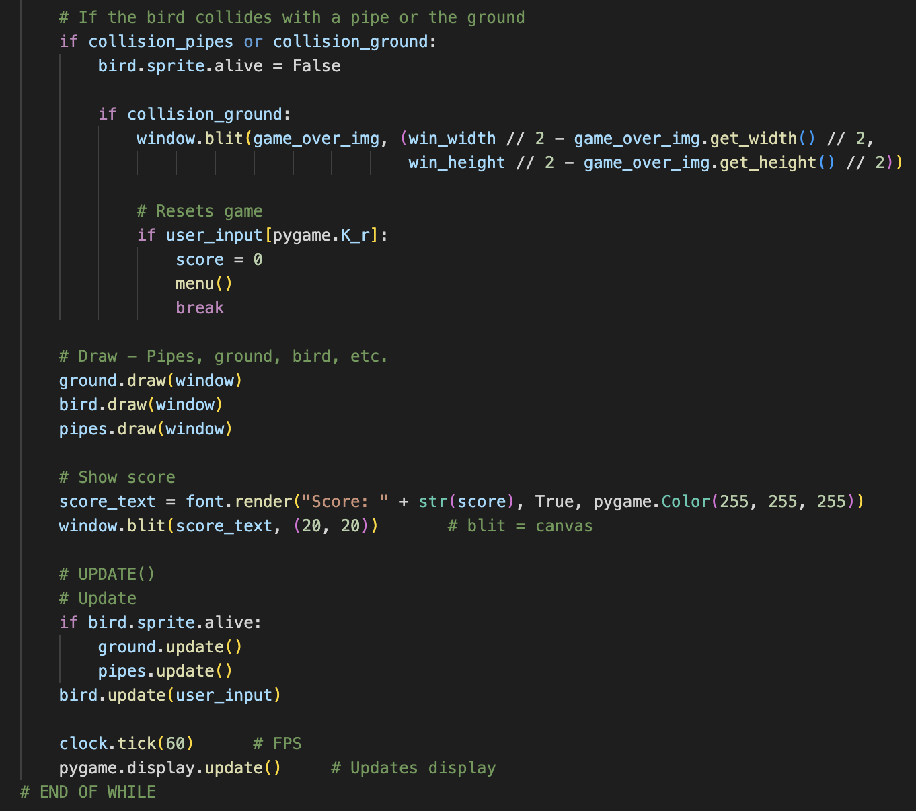
Code
Note: I followed a tutorial

Slide 5
Live Demo

